Slide 1

SOA Project Review-1
Smart Item Recovery Portal AI Driven Smart Matching Management System
Under the Guidance of
Dr. P. Krishnanjaneyulu
Assistant Professor,
Department of Computer Science and Engineering,
KLH CSE Bowrampet Campus
Team Members
P. Kavya Sai - 2420030322
K. N. C .Sphoorthy - 2420030510
D. Poojitha - 2420030697

Slide 2
Problem Statement
•Traditional lost and found systems mainly depend on manual reporting, record keeping, and searching, which makes the process time-consuming, inefficient, and difficult to manage as the number of users and items increases.
•Users often have to manually compare the descriptions of lost and found items, while the absence of an intelligent matching mechanism can result in potential matches being missed.
•In addition, conventional systems may provide limited security, scalability, and flexibility when managing user information and item records.

Slide 3
Solution
Our proposed solution to this problem is:
A secure, scalable, and intelligent Lost & Found Management System that can automate item management, securely handle user access, and use AI-based matching techniques to identify potential matches between lost and found items

Slide 4
Objectives
•The main objective of this project is to develop a secure, scalable, and intelligent Lost & Found Management System using SOA and Microservices Architecture.
•The system aims to provide secure user authentication and role-based authorization using Spring Security and JWT, enable dynamic service registration and discovery using Eureka, and manage service communication through Spring Cloud API Gateway.
•It also aims to integrate an AI Matching Service using TF-IDF and Cosine Similarity to automatically identify potential matches between lost and found item descriptions.
•The project further focuses on improving scalability, maintainability, modularity, and fault tolerance through independent microservices and databases, while following Agile development and testing practices.

Slide 5
Literature Survey
Authors | Title of the Paper | Methodology | Inferences | Limitation/Future work
Söylemez et al., 2022 | Challenges and Solution Directions of Microservice Architectures: A Systematic Literature Review | •Systematic Literature Review of 3,842 papers; 85 selected as primary studies | •Identifies major challenges in Microservices Architecture, including scalability, reliability, availability, service management and maintainability. | •Further research is required to address the identified challenges and improve successful MSA adoption.
Tokmak et al., 2024 | Web Service Discovery: Rationale, Challenges, and Solution Directions | •Systematic Literature Review; 54 papers analyzed | •Highlights service discovery as an important challenge in SOA and microservice environments and analyzes existing discovery techniques. | •More effective and scalable service discovery approaches are required as the number of services increases.
Assessment of Performance and Scalability, 2025 | Assessment of Performance and its Scalability in Microservice Architectures: Systematic Literature Review | •Systematic review of 801 studies; 29 selected for detailed quality assessment | •Shows that microservice performance and scalability are influenced by architecture, deployment and usage. | •Existing studies use diverse approaches, making comparison difficult; further standardized evaluation is needed.

Slide 6
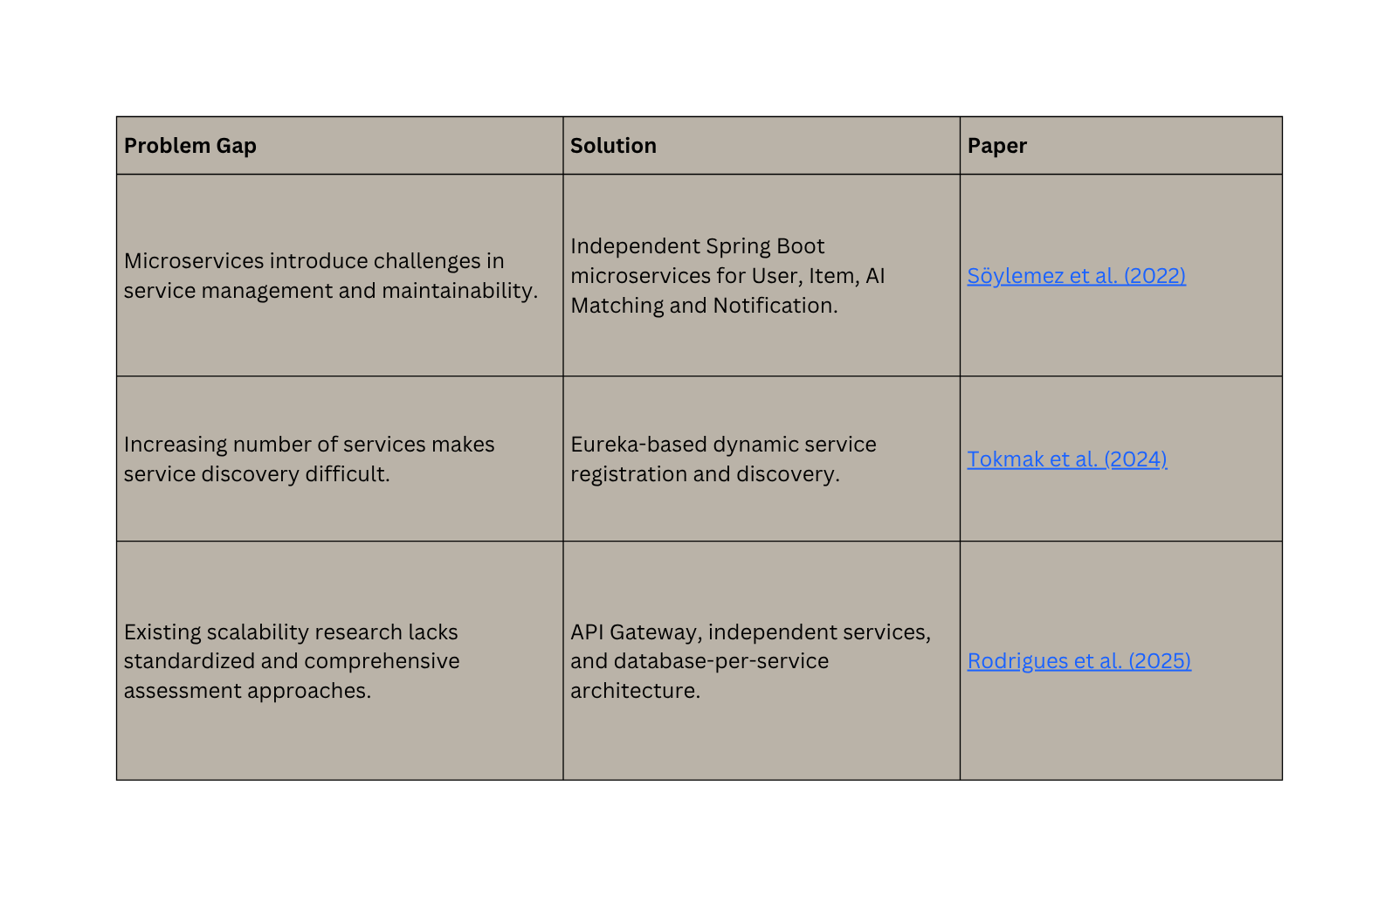
Problem Gap Identification

Slide 7
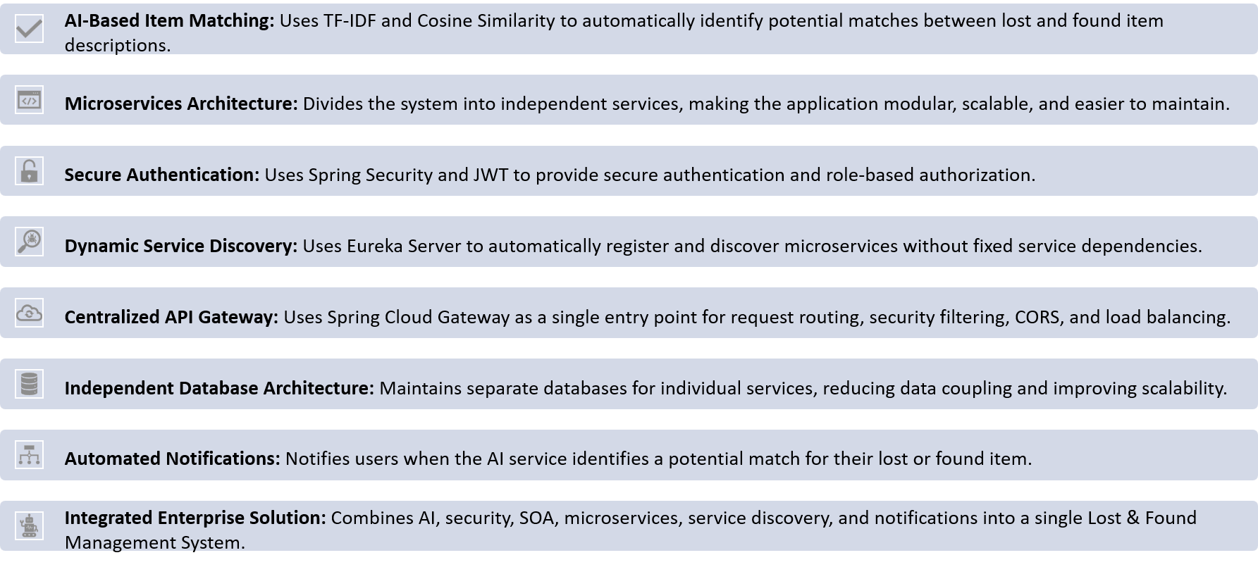
Innovation ,Creativity and Novelty

Slide 8
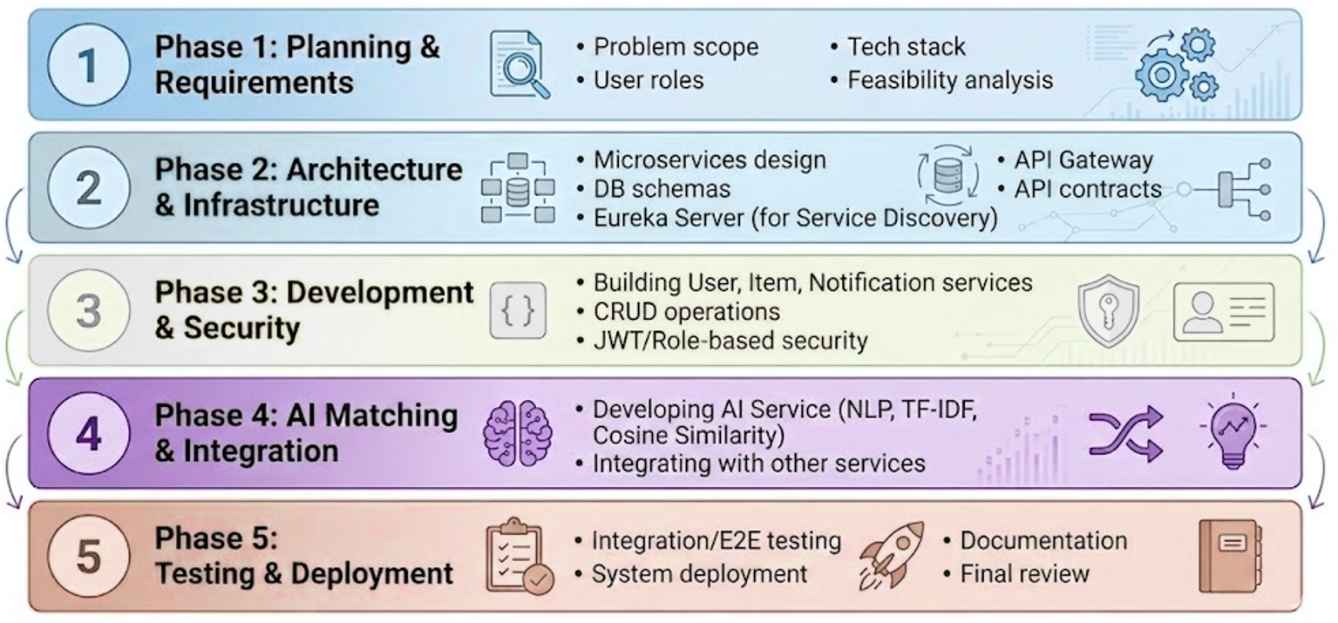
Feasibility and Project Plan
Duration
1 WEEKS
1-2 WEEKS
1 WEEK
1-2 WEEKS
1 WEEK

Slide 9

Conclusion
“The project provides a scalable and efficient microservices-based platform to simplify the process of reporting, finding, and recovering lost items on campus.”

Slide 10
Thank
You

